Slide 1
Login/Registration Page
Wireframe

Slide 2
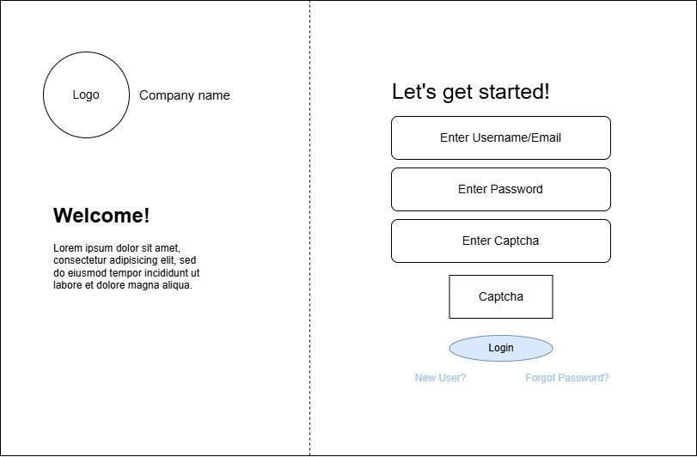
Login Page

Slide 3
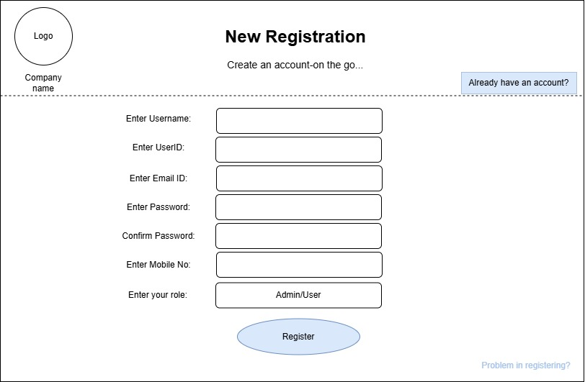
Registration Page

